Slide 1

Welcome to my session

Slide 2
Introduce
Teacher
Lesson
Shilpi Rani Das
Assistant teacher.
Kamalpur kumudgonj Govt.
Primary School
Purbadhalla,Netrakona.
Class:one
Subject:English
Lesson:7
Todays Lesson:Parts of the body
Time:4o minutes
Date:25.05.2013

Slide 3
Learning Outcomes:
Students will be able to--
1.Say the word (Head,Eye,Ear,Nose)
2.Recognize the parts of the body(Head,eye,ear,nose)

Slide 4
Lets recite a rhyme

Slide 5
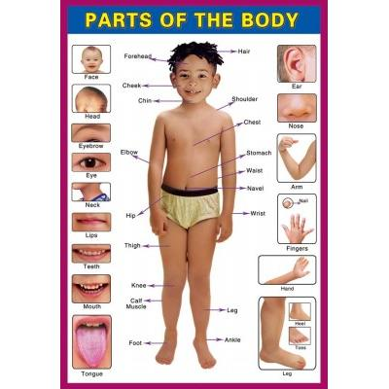

Slide 6
Todays lesson
Parts of the body

Slide 7
Look at me
1.Head
2.Ear
3.eye
4.Nose

Slide 8

Look at the picture
head
eye
ear
nose

Slide 9
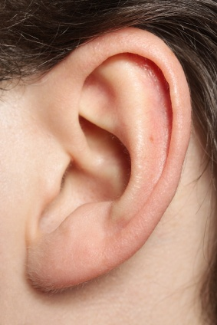
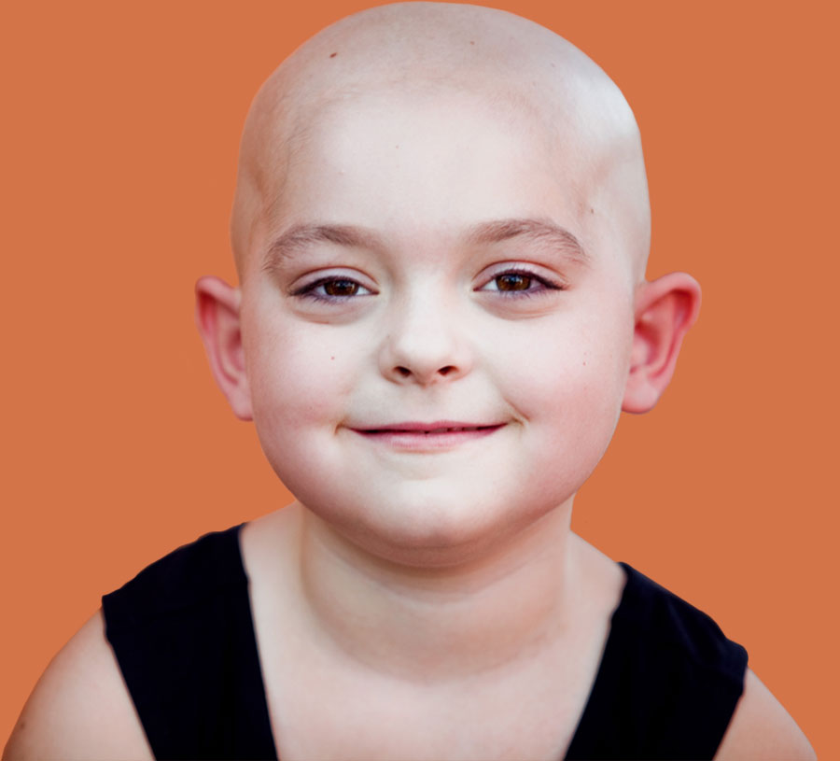
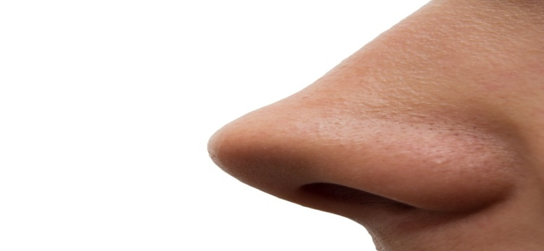
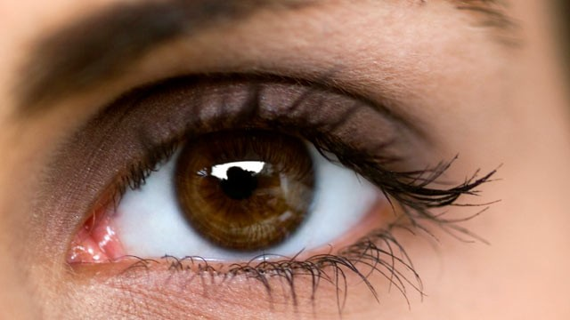
What is it
Head
Ear
Nose
Eye

Slide 10
Do in group
Touch your-head,eye, ear,nose.

Slide 11
Pair work
Touch your -----head, eye, ear, nose.

Slide 12
Evalution
Point and say-------
Head

Slide 13
Ear

Slide 14
Eye

Slide 15
Nose

Slide 16

Thank you

